Slide 1

Deekseek Overview
Paper review
Gibeom Kim (UST)

Slide 2

Index
Paper abstract
1-1. Mixture of experts(MoE)
Model
Conclusion

Slide 3
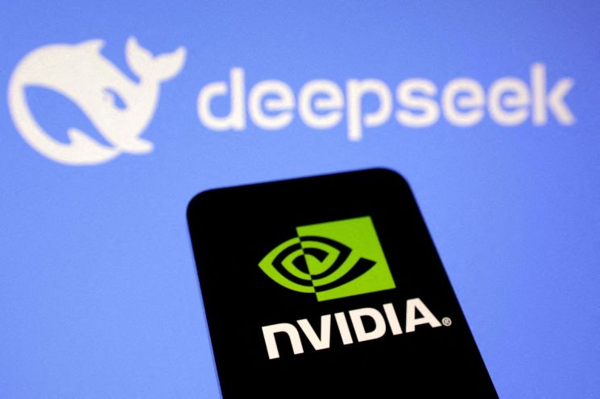
1. Paper abstract

Slide 4
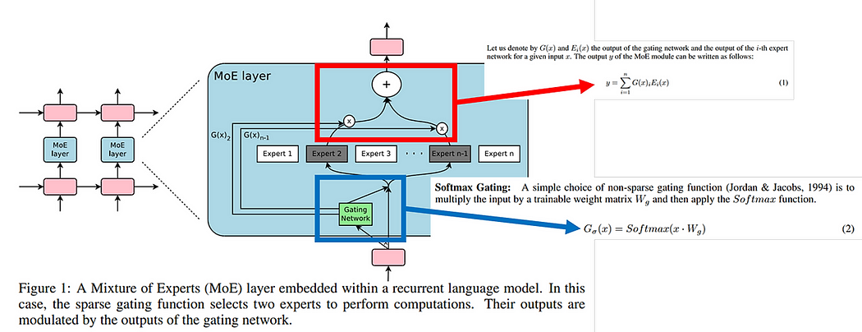
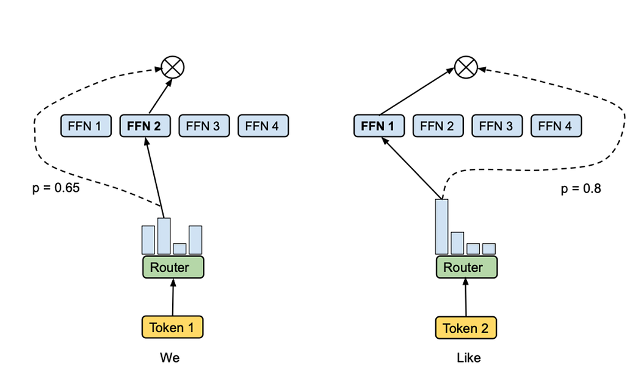
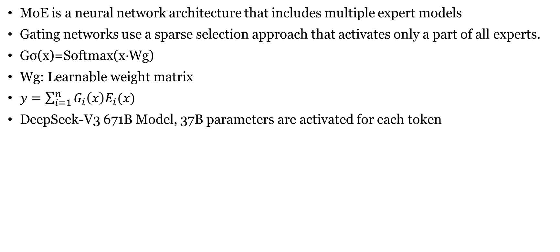
1-1. Mixture of experts(MoE)
MoE is a neural network architecture that includes multiple expert models
Gating networks use a sparse selection approach that activates only a part of all experts.
Gσ​(x)=Softmax(x⋅Wg​)
Wg: Learnable weight matrix
$y=\sum_{i=1}^{n}{G_{i}\left(x\right)E_{i}(x)}$
DeepSeek-V3 671B Model, 37B parameters are activated for each token

Slide 5
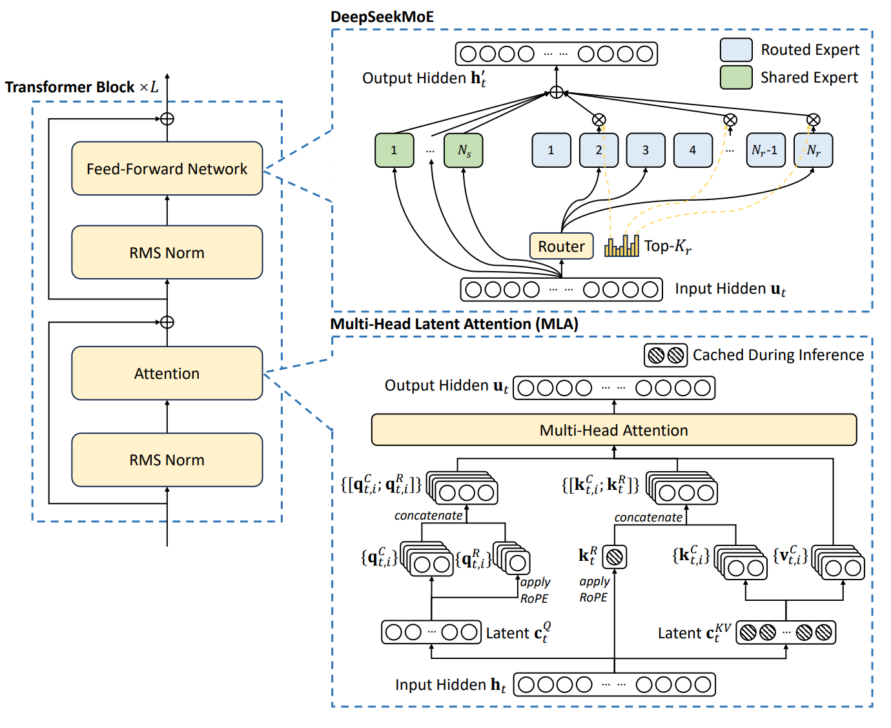
2. Model

Slide 6
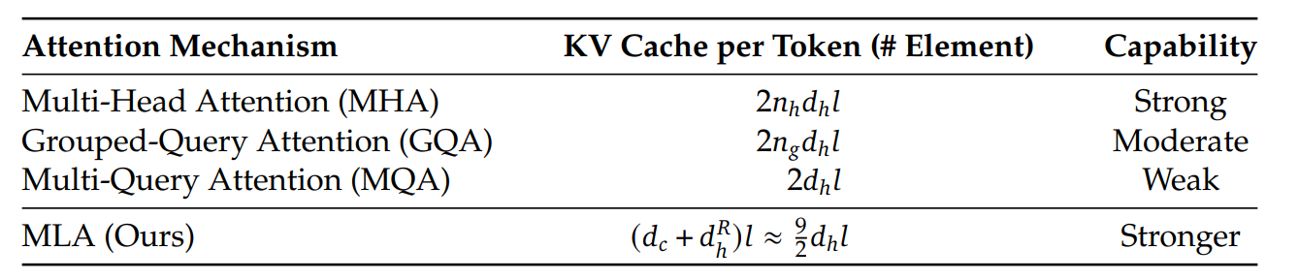
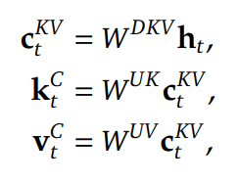
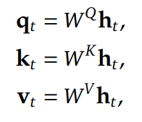
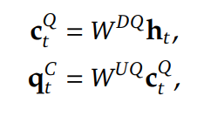
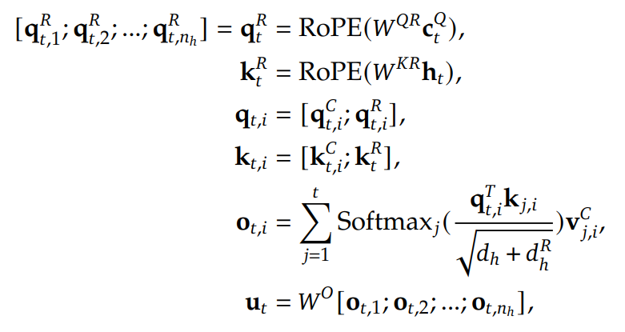
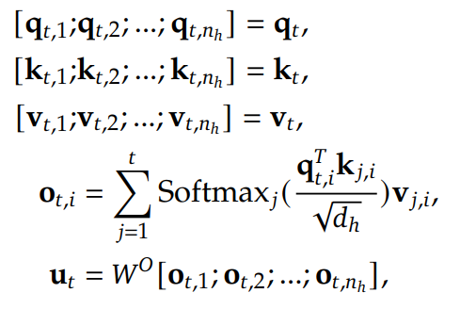
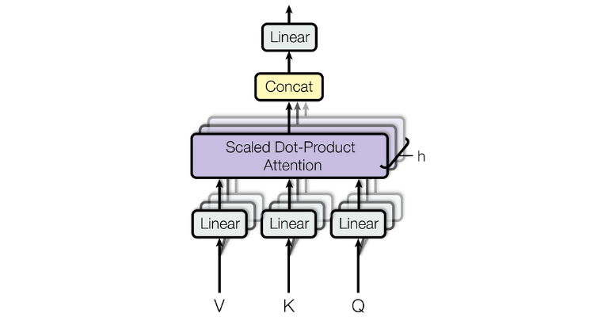
2. Model
Use Multi-Head Latent Attention
The core of MLA is the low-rank joint compression for keys and values to reduce KV cache.
Multi-Head Latent Attention
Multi-Head Attention
Notes:
Multi head attention
Some attention concentrate to Context or Relation between words or which word is subject

Slide 7
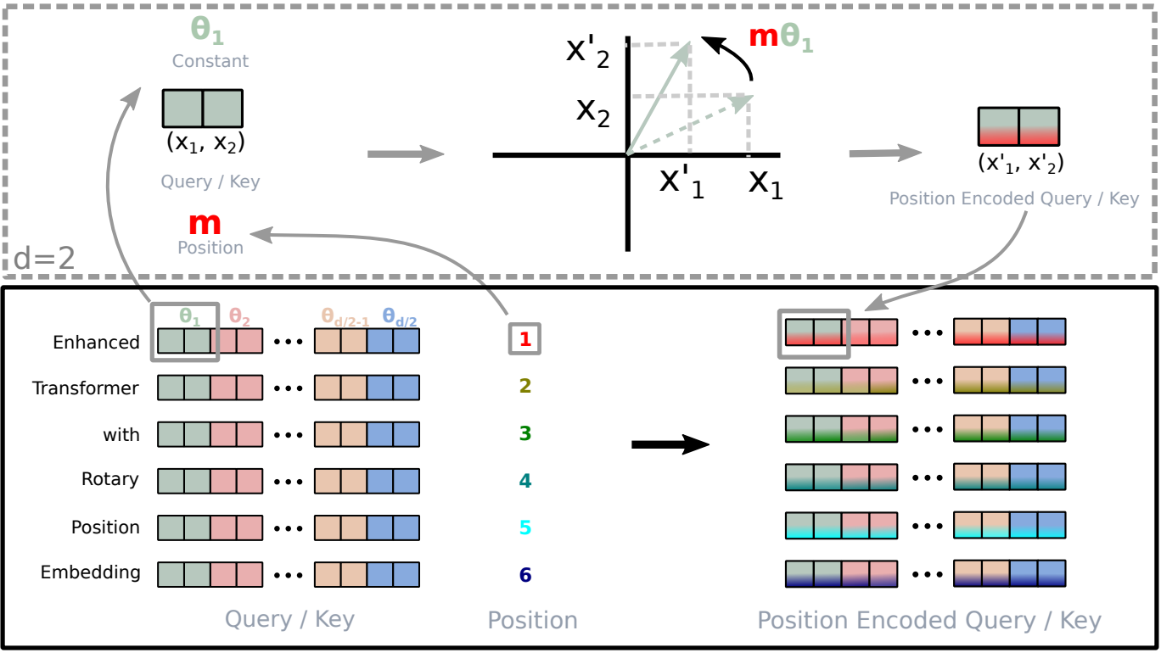
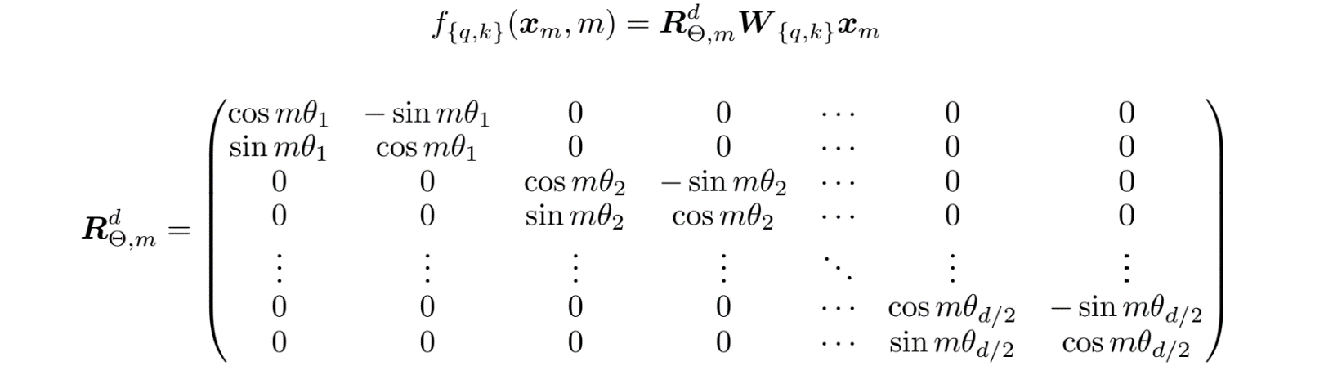
2. Model
Rotary Position Embedding(ROPE)
Traditional location embedding directly learns and utilizes an embedding vector for the actual location of the token
However, there are many cases where “relative distance” is important in context
Notes:
(예: i번째 토큰과 j번째 토큰이 얼마나 떨어졌는지)

Slide 8
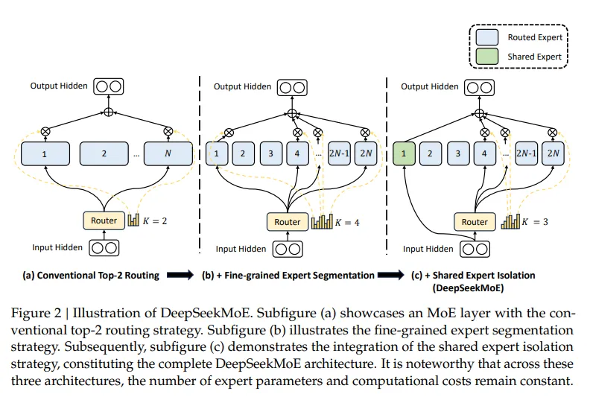
2. Model
DeepSeekMoE
Notes:
Shared expert : common knowledge
Routed expert: specalized knowledge

Slide 9
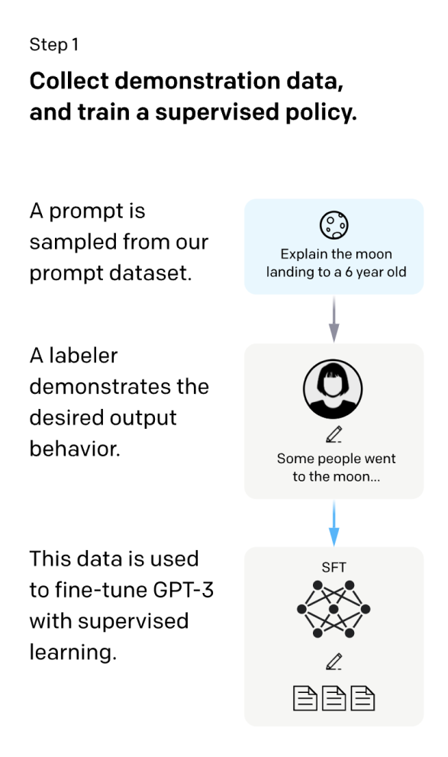
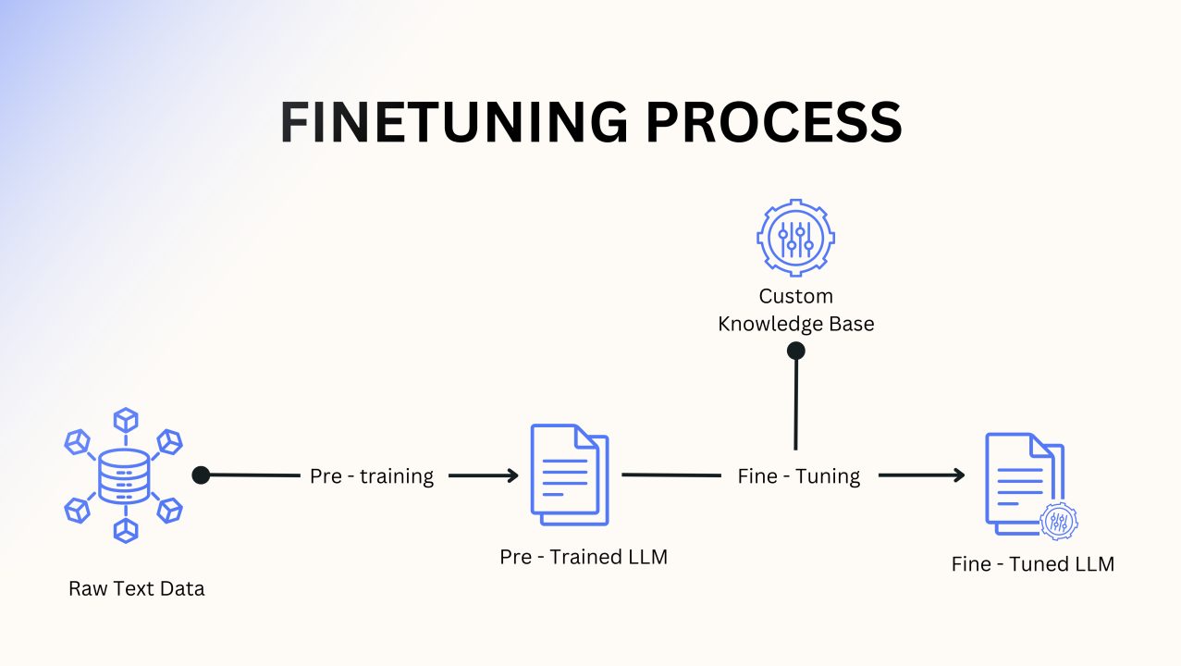
2. Model
Alignment method
Supervised Fine-Tuning(SFT)
Reinforcement Learning

Slide 10
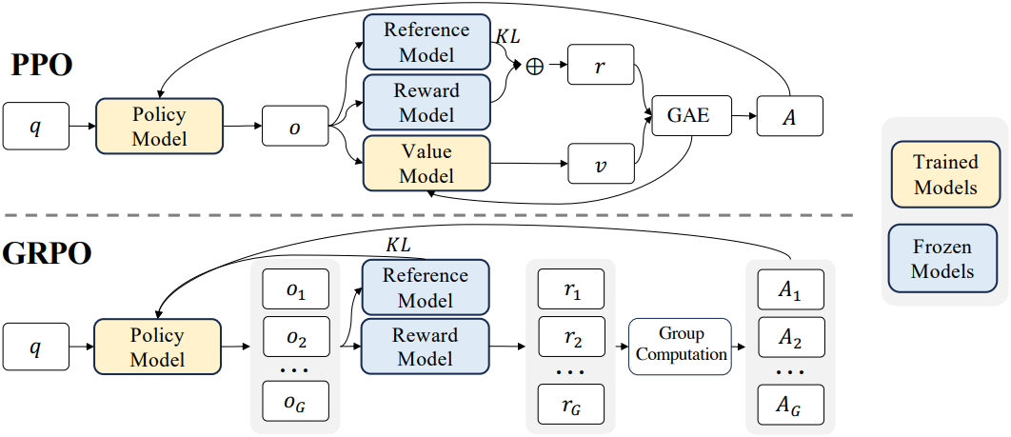
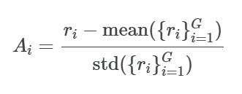
2. Model
Reinforcement Learning
Notes:
비평가(Critic) 모델 없이 정책(policy) 학습을 실시
각 출력 간의 상대적 보상 차이를 계산하여 정책을 업데이트

Slide 11
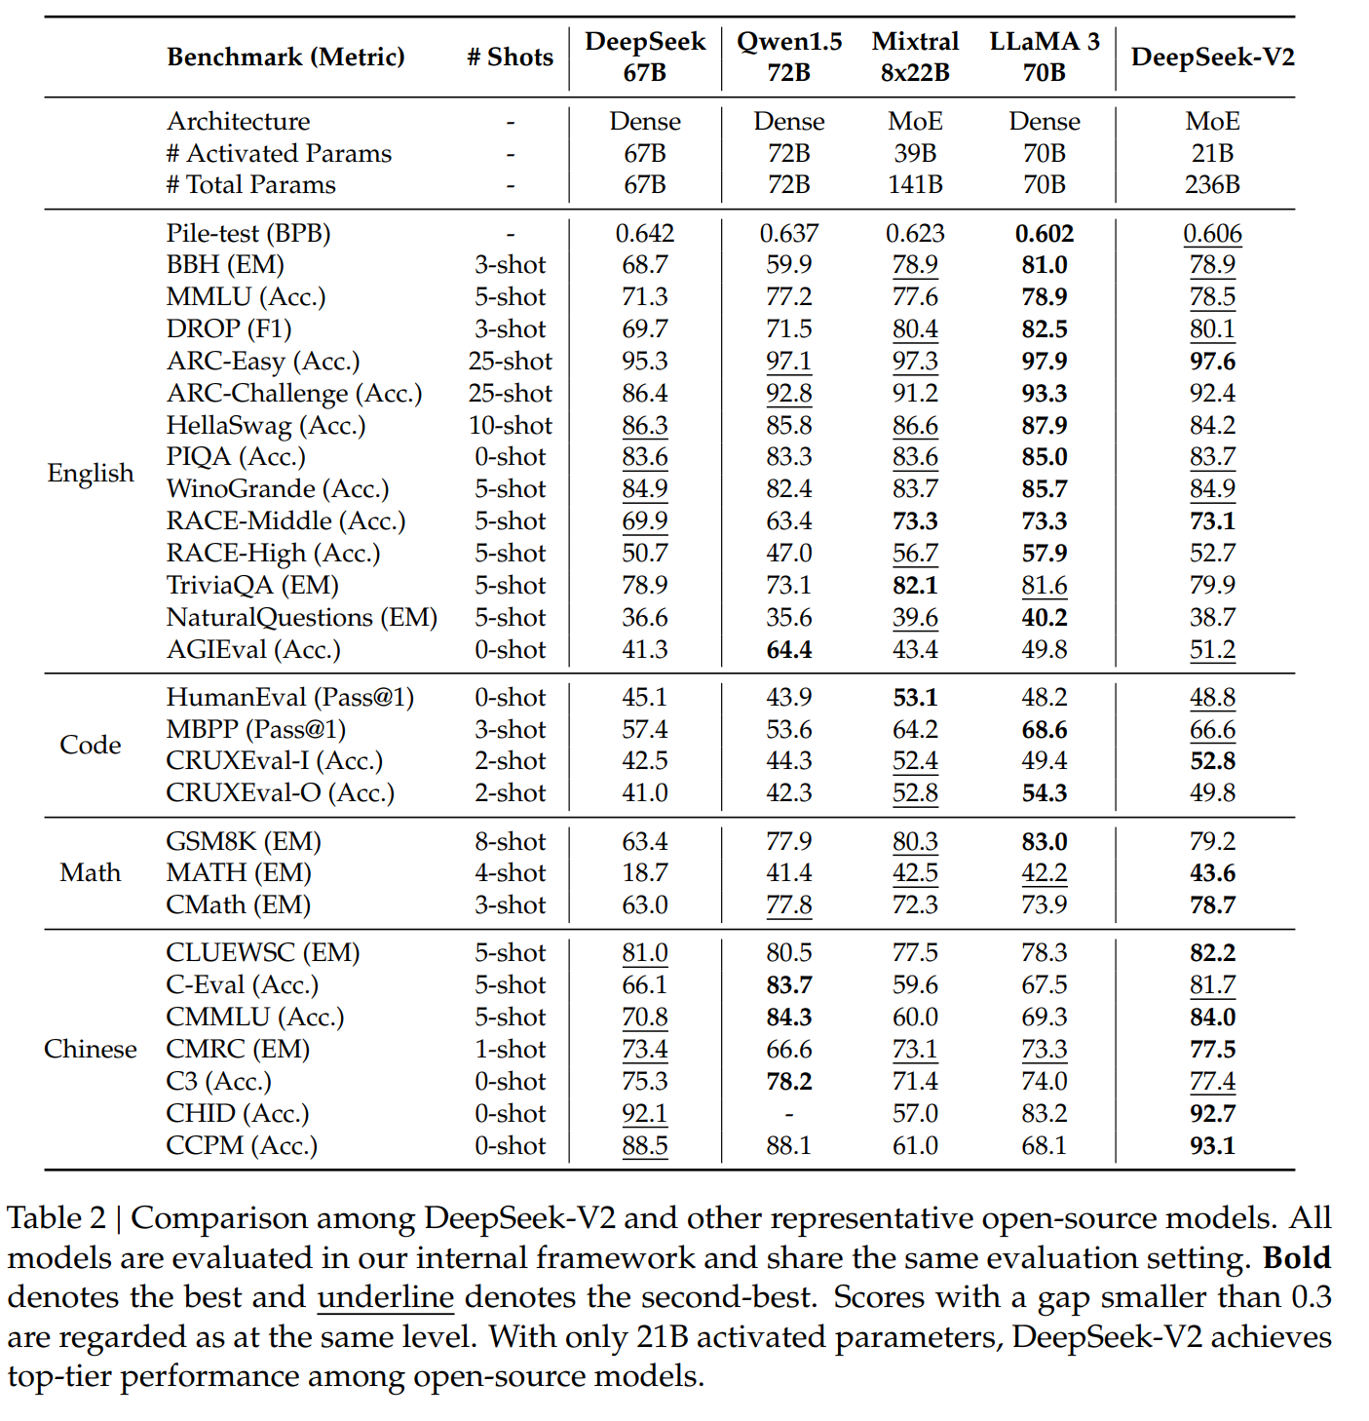
2. Model

Slide 12
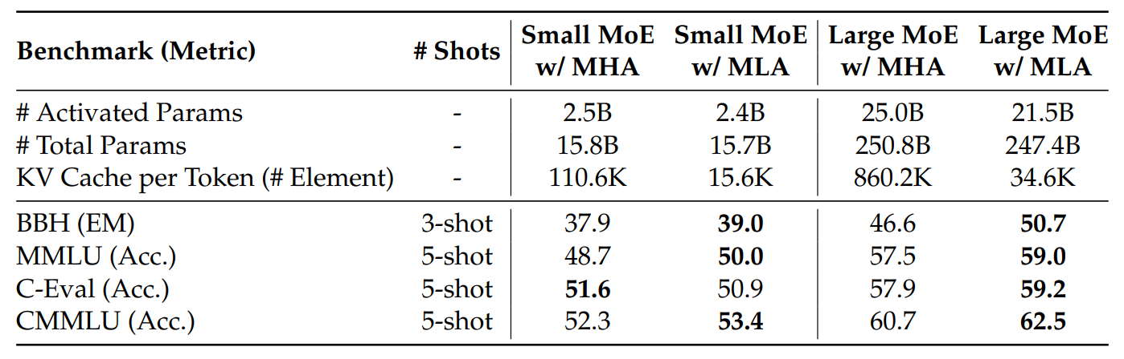
2. Model
Reduced KV cache size by 93.3%, significantly reducing storage compared to MHA.
5.76x faster inference speed with MLA.
42.5% reduction in training cost while showing stronger performance compared to DeepSeek 67B.

Slide 13
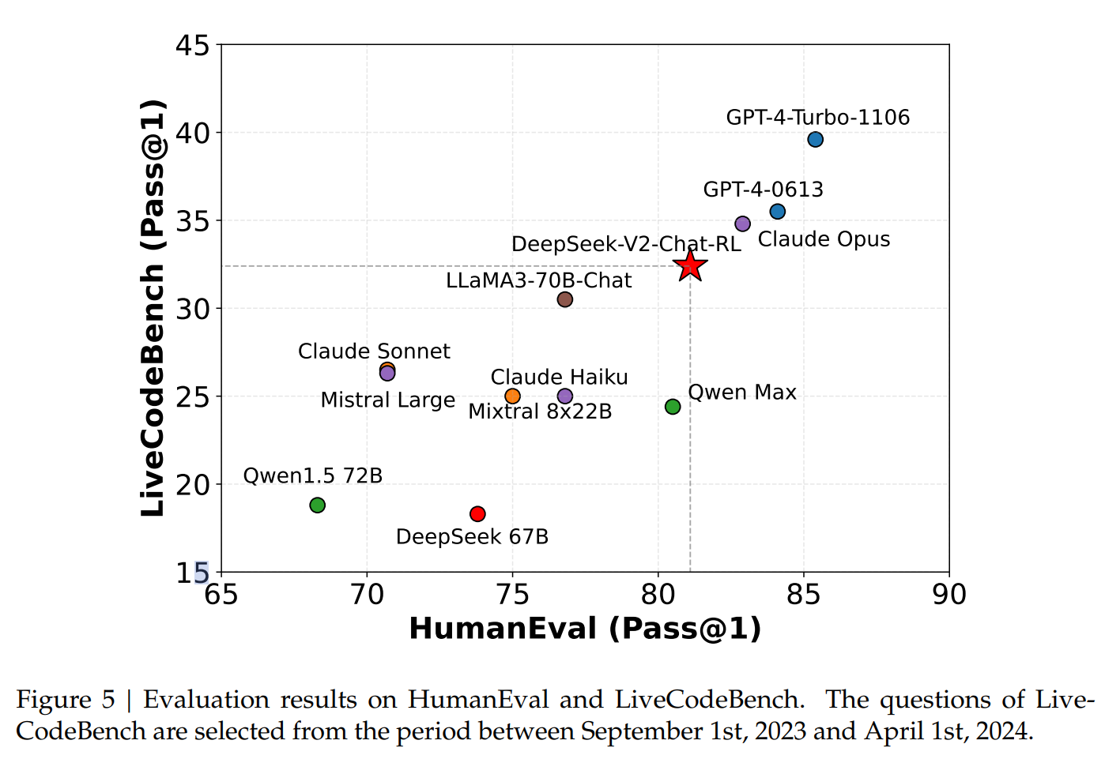
2. Model

Slide 14
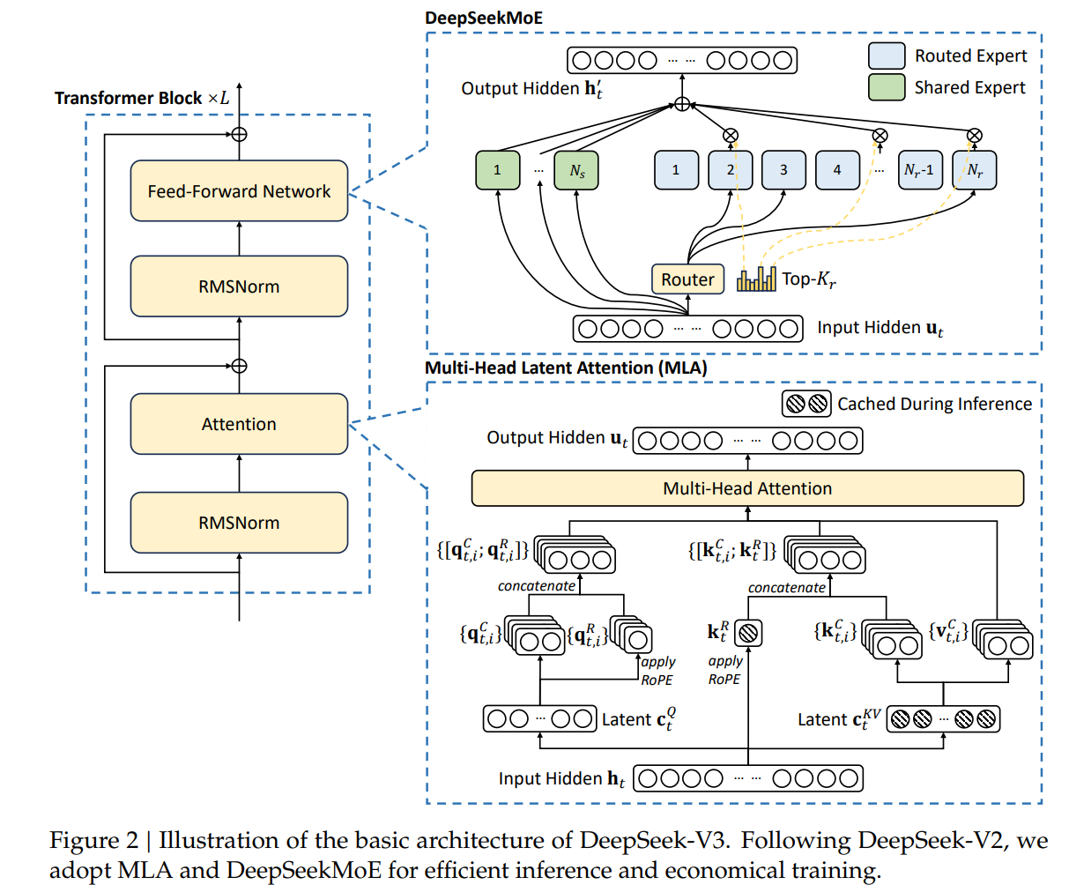
2. Model
671B Parameter, but 37B are activated for each token
Training cost is approximately 2.79 million hours on 1 H800 GPU, totaling $5.57 million
GPT-4O training cost is approximately $100 million

Slide 15
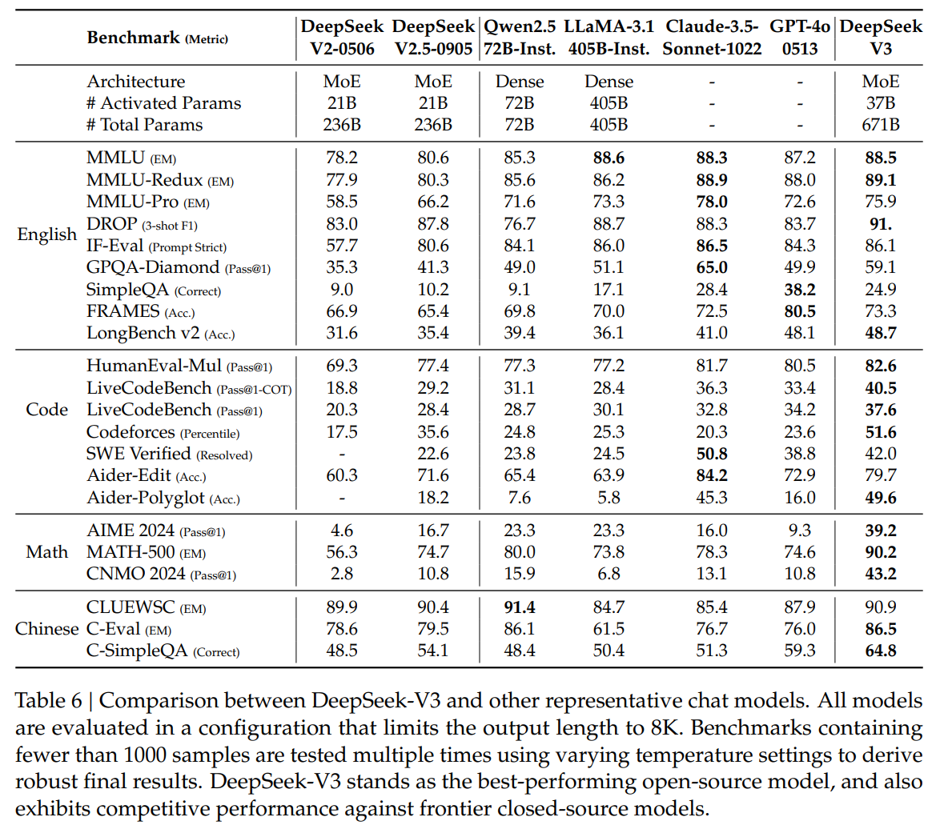
2. Model

Slide 16
3. Conclusion
DeepSeek significantly improves inference speed and memory efficiency by compressing Key-Value caches into low-dimensional spaces with Multi-Head Latent Attention (MLA).
It introduces GRPO-based reinforcement learning, enabling efficient and stable training without requiring a critic model by leveraging group-level relative rewards.
The model demonstrates high performance in code and mathematical reasoning tasks and is optimized to generate user-aligned responses through human preference alignment.

Slide 17
3. Conclusion
<Q>
Find the number of times a hexagonal dice is rolled five times such that the sum of the numbers rolled is 15. Just say answer only.
<A>
651
<Result>
GPT-4O: Incorrect, 3.66 sec
GPT-O1: Correct, 15.01 sec
Deepseek v3: Correct, 5.10 sec
Deepseek r1: Correct, 150.37 sec

Slide 18
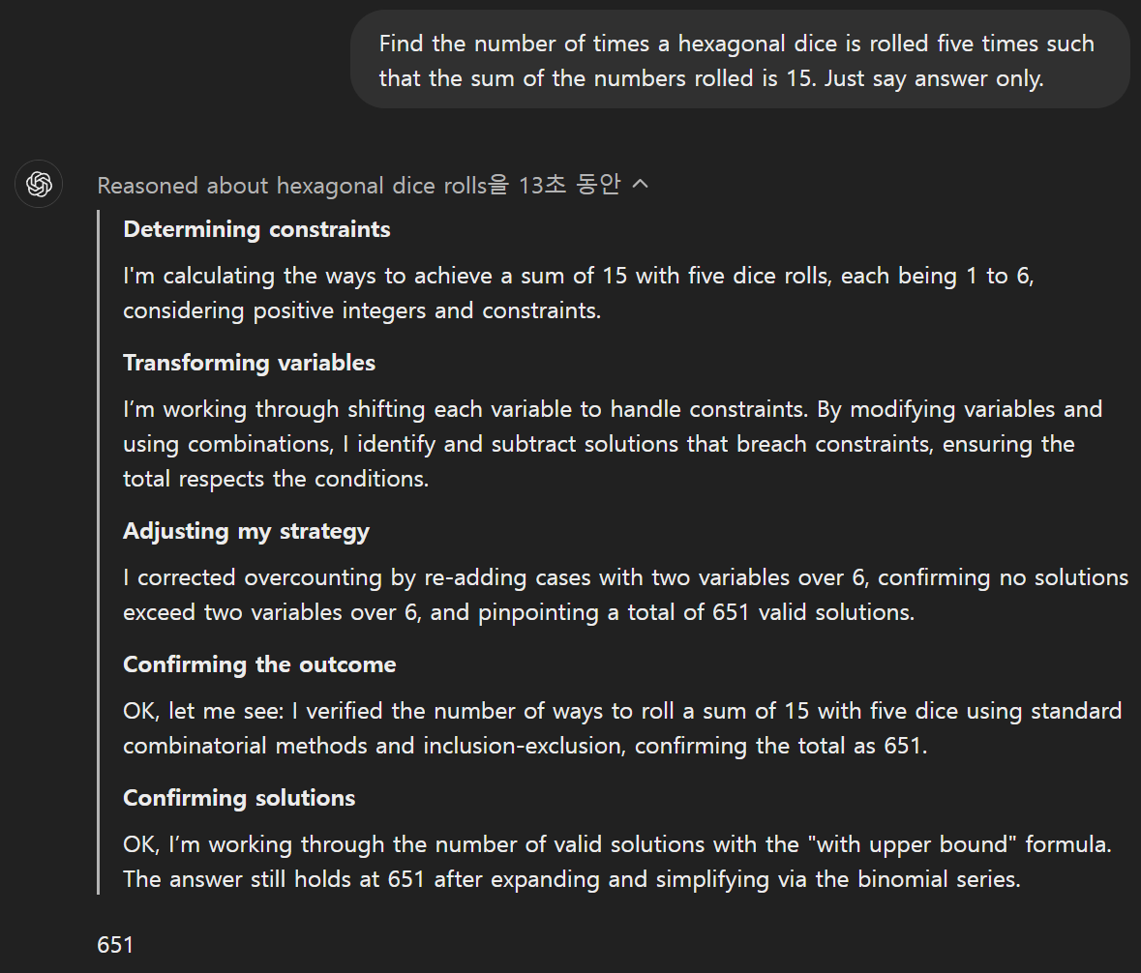
3. Conclusion

Slide 19
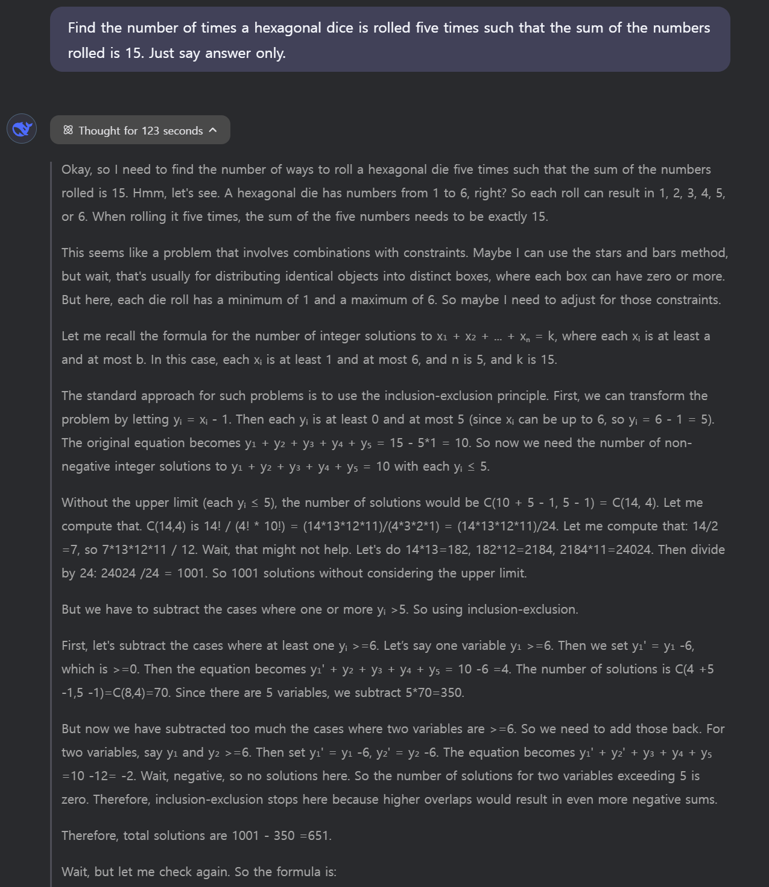
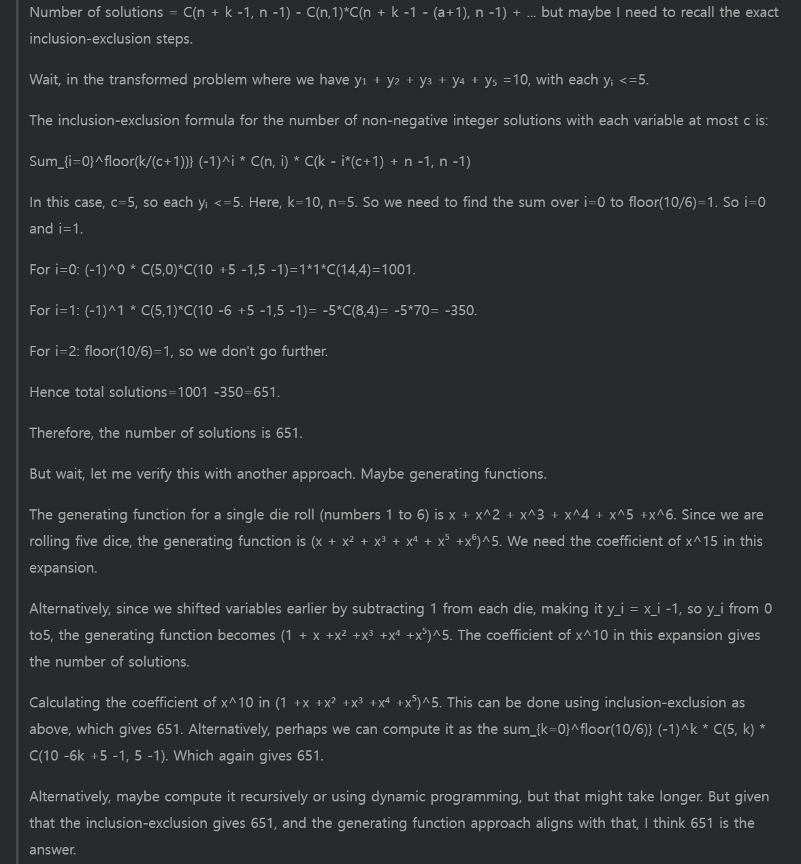
3. Conclusion

Slide 20
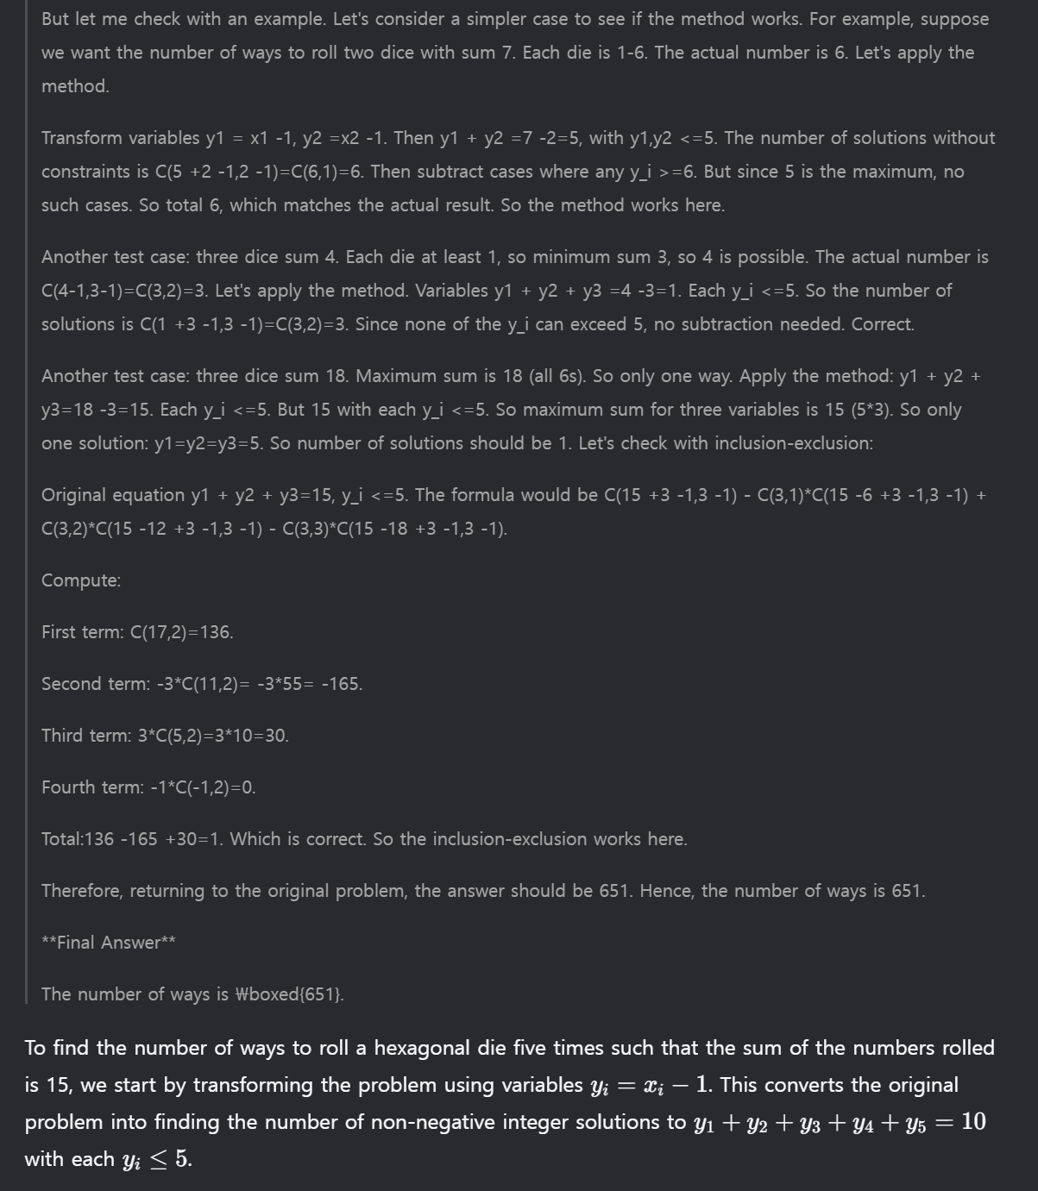
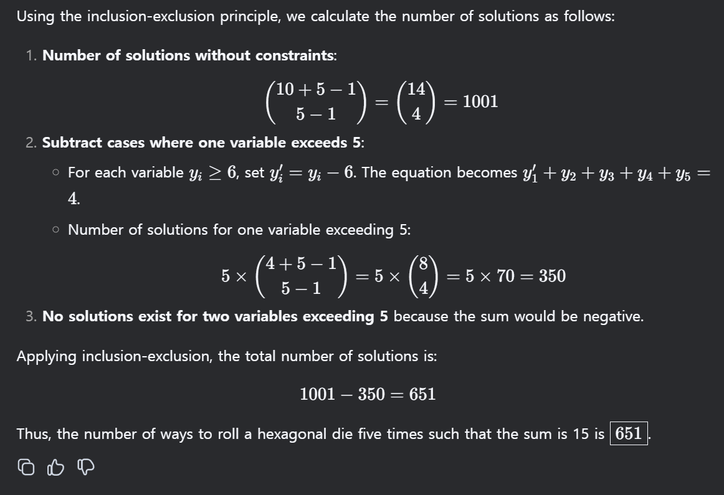
3. Conclusion

Slide 21
Thank you

